Slide 1
Project Title: Simultaneous Equations
Group Members:
Unaiza Khalid (21/F-BSAI-11)
Rabia Imran (21/F-BSAI-40)
Submitted to: Ms. Sofia Hajano

Slide 2
What are Simultaneous Equations?
Simultaneous equations are two or more algebraic equations that share variables e.g. x and y.
They are called simultaneous equations because the equations are solved at the same time.
For example, below are some simultaneous equations:
2x + 4y = 14 4x − 4y = 4
6a + b = 18 4a + b = 14
3h + 2i = 8 2h + 5i = −2

Slide 3
Conti…
Each of these equations on their own could have infinite possible solutions.
However when we have at least as many equations as variables we may be able to solve them using methods for solving simultaneous equations.
We can consider each equation as a function which, when displayed graphically, may intersect at a specific point. This point of intersection gives the solution to the simultaneous equations.

Slide 4
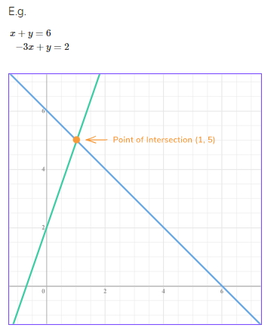
Conti…
When we draw the graphs of these two equations, we can see that they intersect at (1,5).
So the solutions to the simultaneous equations in this instance are:
x = 1 and y = 5

Slide 5

Solving Simultaneous Equations:
When solving simultaneous equations you will need different methods depending on what sort of simultaneous equations you are dealing with.
There are two sorts of simultaneous equations you will need to solve:
linear simultaneous equations
quadratic simultaneous equations
A linear equation contains terms that are raised to a power that is no higher than one.

Slide 6

Conti…
Linear simultaneous equations are usually solved by what’s called the elimination method (although the substitution method is also an option for you).
Solving simultaneous equations using the elimination method requires you to first eliminate one of the variables, next find the value of one variable, then find the value of the remaining variable via substitution. Examples of this method are given below.
A quadratic equation contains terms that are raised to a power that is
no higher than two.
Quadratic simultaneous equations are solved by the substitution method.

Slide 7
How to solve Simultaneous Equations:
To solve pairs of simultaneous equations you need to:
Use the elimination method to get rid of one of the variables.
Find the value of one variable.
Find the value of the remaining variables using substitution.
Clearly state the final answer.
Check your answer by substituting both values into either of the original equations.

Slide 8
Question?
How We Solve this by just putting Coeffieients of x and y?????

Slide 9
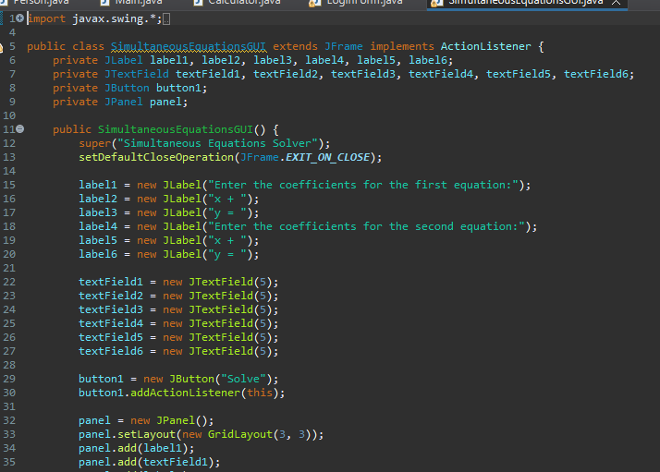
Code For Simultaneous Equations:

Slide 10
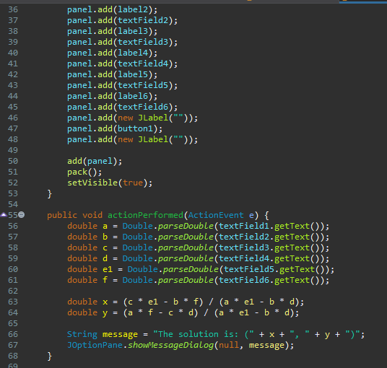
Conti…

Slide 11
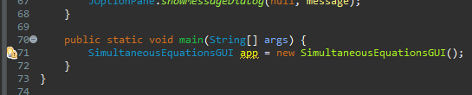
Conti…

Slide 12

Detailed Explaination:
Firstly, we create the package which named as “eqn” and then select the class that would be named as simultaneous equation solver. We initialize the panels, labels, text-field and buttons like that:

Slide 13
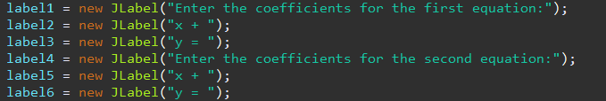
Conti..
And then, we are creating the labels in it for the purpose to indicate the value of x and y and making the third column for the constant same as equation 2 the written form given below.

Slide 14
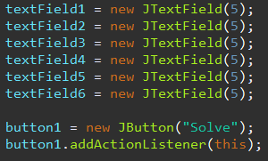
Conti..
then creating the text-fields where the user insert the values of coefficients and then click on the solve and get the answer in the form next tab where the answer is given in the form of Solution Set(x , y) which is exactly our intersecting point of x and y co-ordinate the written form like that:

Slide 15
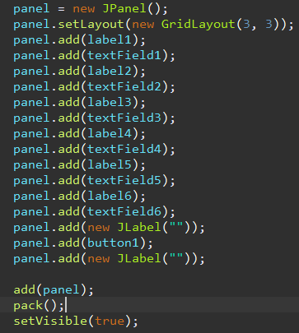
Conti..
Then, we create panel sequence the labels and their text as per required and also set the grid layout or set that it will be visible to us which are given below:

Slide 16
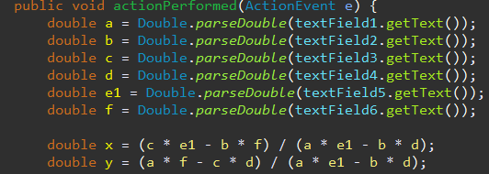
Conti..
The logic is to solve both equations which are given below:

Slide 17
Conti..
Further On, we create the dialogue box for the solution and set the conditions like that:
and creating the panels also, we using the double where the answer would be given in the form of points and at last we create the main method where we call the equation app given below:

Slide 18
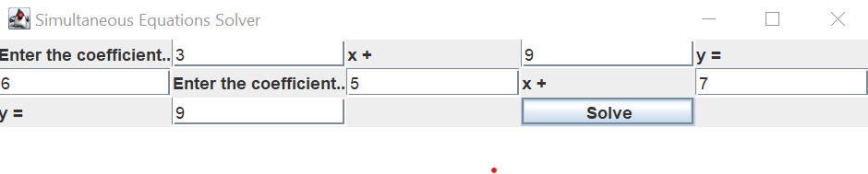
OUTPUT::
Output declares as that we insert the coefficients of x and y and then our program solve it by the logic which we used in it and then the answer is shown in the form of solution set in a dialogue box.
Here’s the result given below:

Slide 19
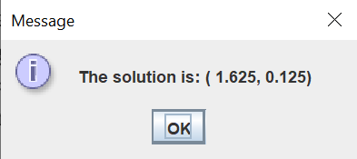
Conti..
And here the dialogue box shows the output:

Slide 20
THANK YOU ☺!

